Slide 1
What is ado.net?
you can think of ADO.NET, as a set of classes (Framework), that can be used to interact with data sources like Databases and XML files.
retrieved data can be consumed in any .NET application.
ADO stands for Microsoft ActiveX Data Objects:
Several common objects are needed:
1. Connection – to connect to the database 2. Command – to run an sql command/Query 3. DataReader – to retrieve data from db 4. DataAdapter 5. DataSet
* dataset/ dataAdapter are legacy technologies and not in use after .Net 3.5

Slide 2
Databases like ms SQL only understand SQL ( STRUCTURED QUERY LANGUAGE ).
If a .NET application ( Web, Windows, Console etc.. ) has to retrieve data, then the application needs to:
1. Connect to the Database 2. Prepare an SQL Command 3. Execute the Command 4. Retrieve the results and display some data in the application

Slide 3
DB apps with entity framework (ef)
Entity framework is a “standart” for orm technology in c# & .net
EF ALLOWS US TO “MAP OBJECTS” FROM RELATION DATABASES LIKE MSSQL TO OBJECT-ORIENTED MODEL IN c# WITH “DATABASE-FIRST” & “CODE-FIRST” APPROACHES
POWERFULL OBJECT-ORIENTED API for requests to The db
crud performance
ORM is simply the concept of processing data from a relational database and modeling it in a format that is more readily usable by your code.
Instead of looping through rows in a table you model each row as an object and loop through a collection of objects, called entities.

Slide 4
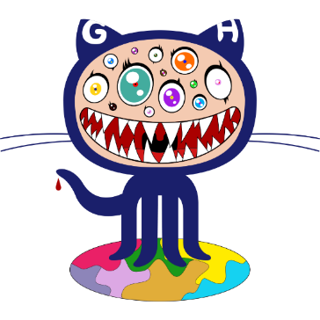

Getting ‘shits’ done by using GitHub & AppHarbor
GitHub is web-based Git or version control repository tool.
Distributes version control and SCM – source code management functionality of Git.
GitHub provides a Web-based graphical interface.
It also provides access control and several collaboration features.
GitHub
AppHarBor is fully hosted .NET platform as a service.
Instantly deploy and scale .NET applications using version control tools - Git.
Accessing application trough complimentary apphb.com subdomain.
Top deal: both are free!
Notes:
At the heart of GitHub is Git, an open source project started by Linux creator Linus Torvalds. Matthew McCullough, a trainer at GitHub, explains that Git, like other version control systems, manages and stores revisions of projects. Although it’s mostly used for code, McCullough says Git could be used to manage any other type of file, such as Word documents or Final Cut projects. Think of it as a filing system for every draft of a document.
Some of Git’s predecessors, such as CVS and Subversion, have a central “repository” of all the files associated with a project. McCullough explains that when a developer makes changes, those changes are made directly to the central repository. With distributed version control systems like Git, if you want to make a change to a project you copy the whole repository to your own system. You make your changes on your local copy, then you “check in” the changes to the central server. McCullough says this encourages the sharing of more granular changes since you don’t have to connect to the server every time you make a change.
GitHub is a Git repository hosting service, but it adds many of its own features. While Git is a command line tool, GitHub provides a Web-based graphical interface. It also provides access control and several collaboration features, such as a wikis and basic task management tools for every project.
The flagship functionality of GitHub is “forking” – copying a repository from one user’s account to another. This enables you to take a project that you don’t have write access to and modify it under your own account. If you make changes you’d like to share, you can send a notification called a “pull request” to the original owner. That user can then, with a click of a button, merge the changes found in your repo with the original repo.
These three features – fork, pull request and merge – are what make GitHub so powerful. Gregg Pollack of Code School (which just launched a class called TryGit) explains that before GitHub, if you wanted to contribute to an open source project you had to manually download the project’s source code, make your changes locally, create a list of changes called a “patch” and then e-mail the patch to the project’s maintainer. The maintainer would then have to evaluate this patch, possibly sent by a total stranger, and decide whether to merge the changes.

Slide 5
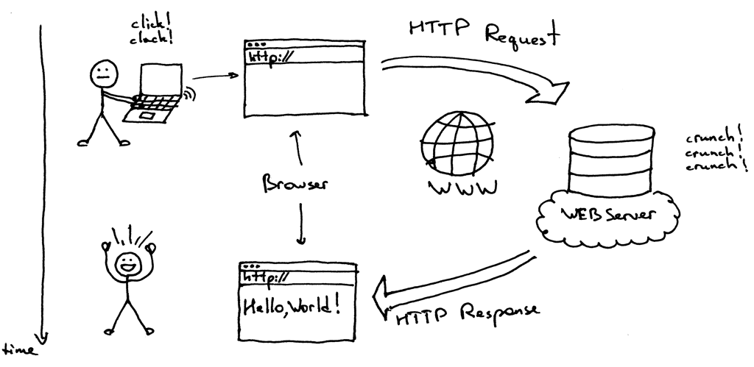
First things first (01)
√ Setting up development environment
Visual Studio
GitHub repository
AppHarbor project
External SQL Server provider

